Slide 1

Face Recognition based login system
Chandu
M22021355

Slide 2
AGENDA :
Introduction
Long-term Goals And Applications
Libraries Used
Functions
Code Snippets
Demo

Slide 3
Face Recognition based login system.
Introduction:
In recent years, face recognition logins have become more and more popular. This technology provides a secure and easy way to confirm user’s identities. The technology in these systems has improved a lot, making them more accurate and reliable. Nowadays, many businesses and organizations are using this authentication method.
The basic concept behind a face recognition-based login system is simple: instead of requiring users to enter a password or PIN code, the system uses facial recognition technology to verify their identity. The system captures an image of the user’s face and analyzes it to determine if it matches the stored image of the user’s face. If the two images match, the system grants the user access.

Slide 4
Long-term Goals and Major Applications :
Patient Identification: Ensuring patient identification in hospitals or clinics, aiding in managing medical records securely.
Access to Sensitive Areas: Enabling restricted access to critical medical facilities or labs.
Behavioral Analysis:
Using facial recognition for analyzing emotions, behaviors, or reactions in various scenarios.
Improving Algorithms: Contributing to advancing facial recognition algorithms for accuracy and reliability.
Event Management: Managing access to events or venues through facial recognition-based ticketing systems.
School Attendance Systems: Automating attendance marking through facial recognition in schools & educational institutions.

Slide 5
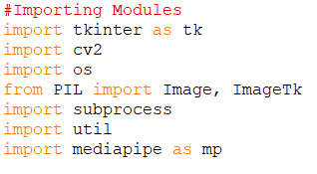
Libraries Imported:
This code represents a simple login system using Python's tkinter library for the graphical user interface (GUI) and OpenCV for webcam access and facial recognition.
tkinter: Used for creating the GUI.
cv2 (OpenCV): Utilized for webcam access and image processing.
os: Used for file and directory handling.
PIL (Python Imaging Library): Utilized for image-related operations.
subprocess: Used for running system commands.
util: A custom module (not provided in the code snippet) that contains some utility functions designed to help in creating various GUI elements such as buttons, labels, entry fields, and message boxes
mediapipe: Used for face detection.

Slide 6
Functions:
__init__: The initializer method for the App class, which sets up the main window, buttons, webcam label, and initializes necessary variables.
add_webcam: Method to add the webcam feed to a specified label and continuously process the webcam frames.
process_webcam: Method that retrieves frames from the webcam, performs face detection, converts frames to PIL format, and updates the displayed image in the label.
add_detections: Method for detecting faces in the webcam frames using the MediaPipe Face Detection module, drawing bounding boxes around detected faces, and indicating potential spoofing.
login: Method executed upon clicking the "Login" button, which captures the current frame, performs facial recognition using an external command (face_recognition), checks for the presence of recognized persons, and checks for liveliness to log in or detect spoofing.
register_user and register_user_tryagain: Methods related to registering a new user, saving captured images, and displaying success messages.
add_img_to_label: Method to update labels with captured images during the registration process.

Slide 7
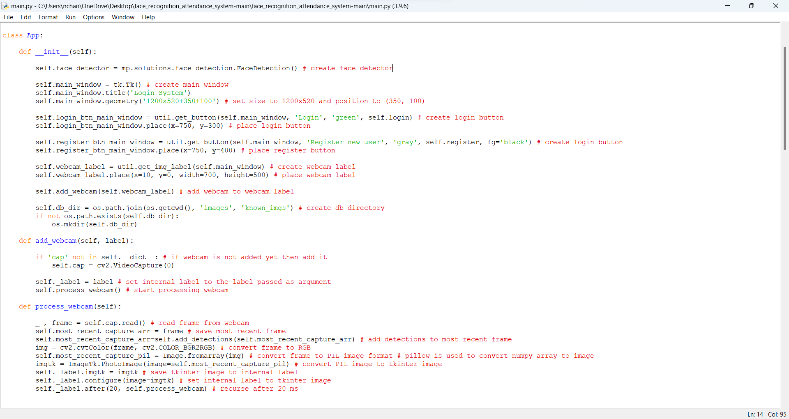
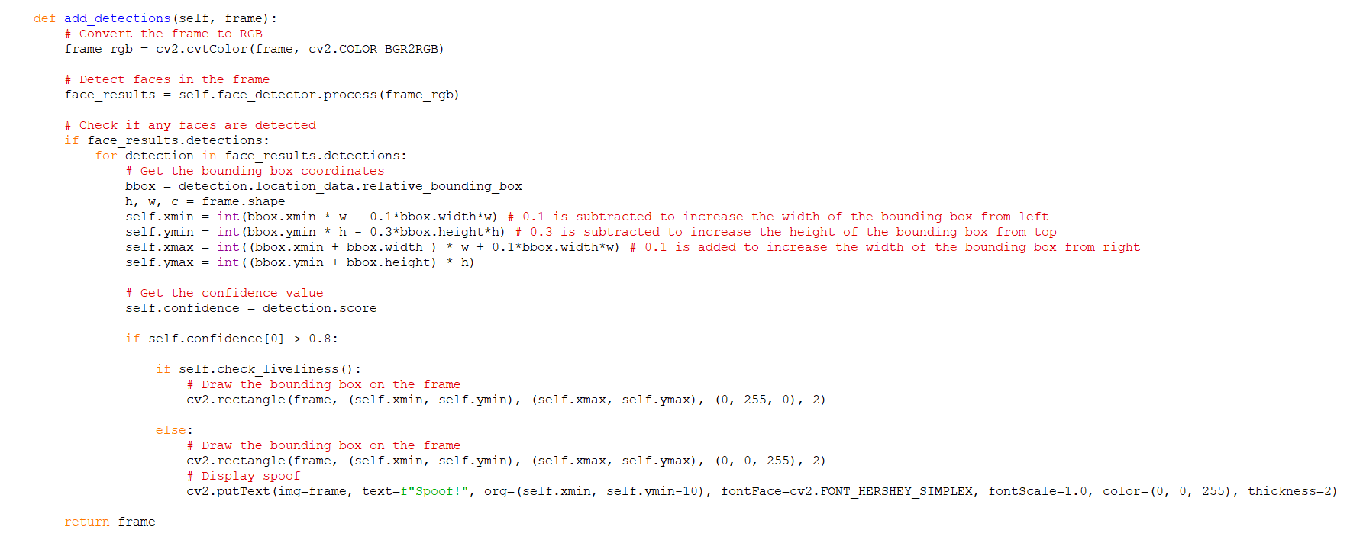

Slide 8
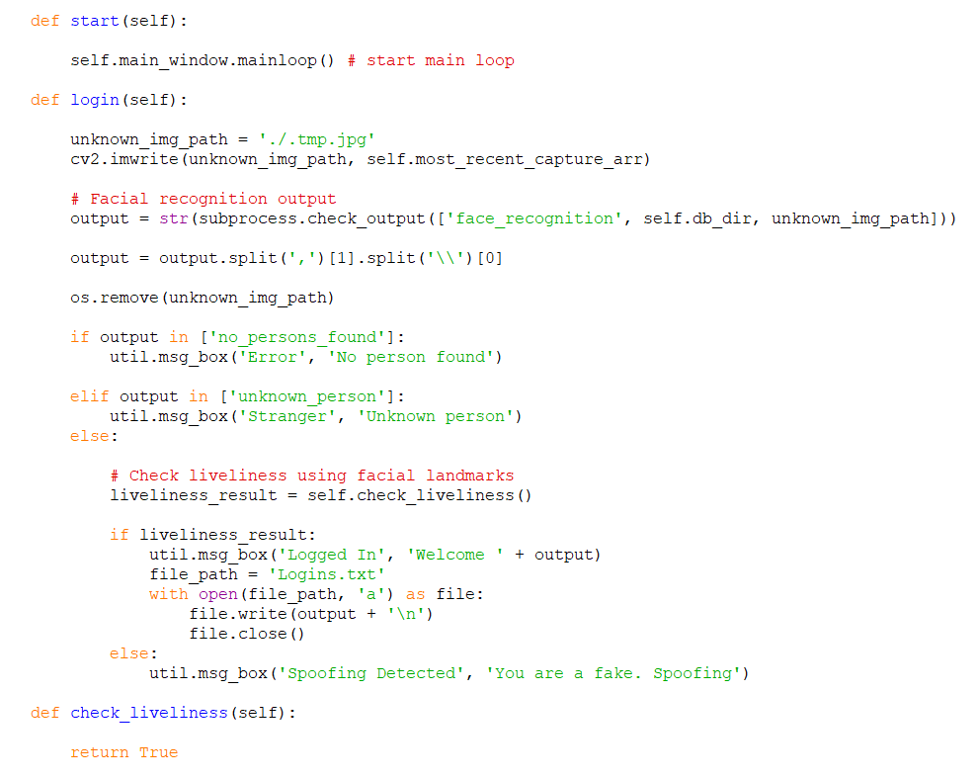
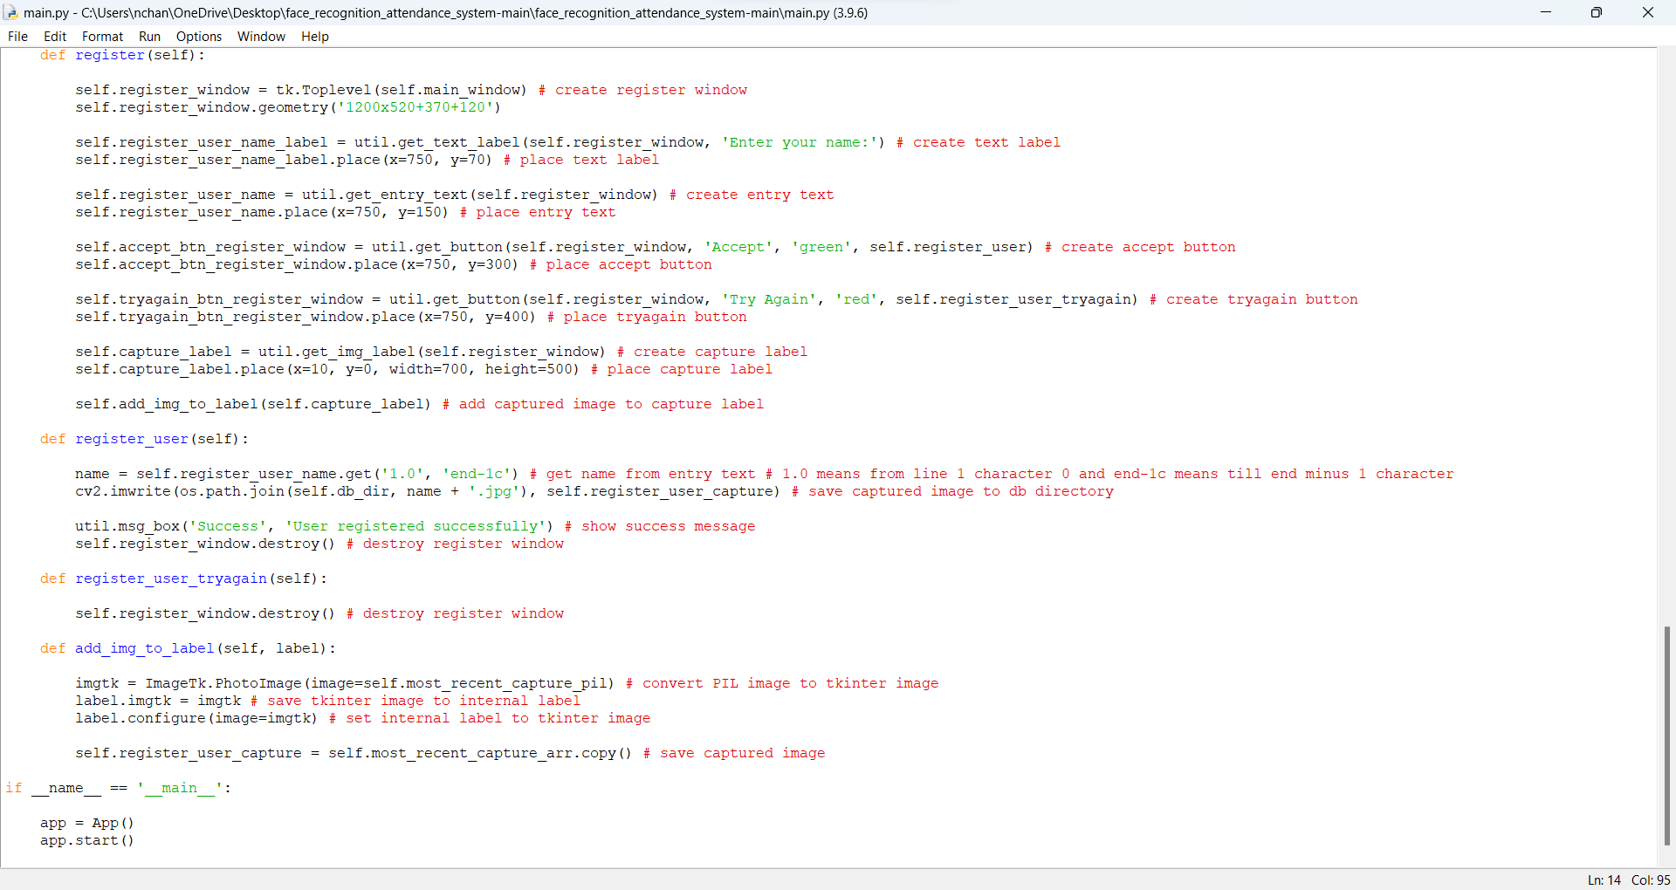

Slide 9
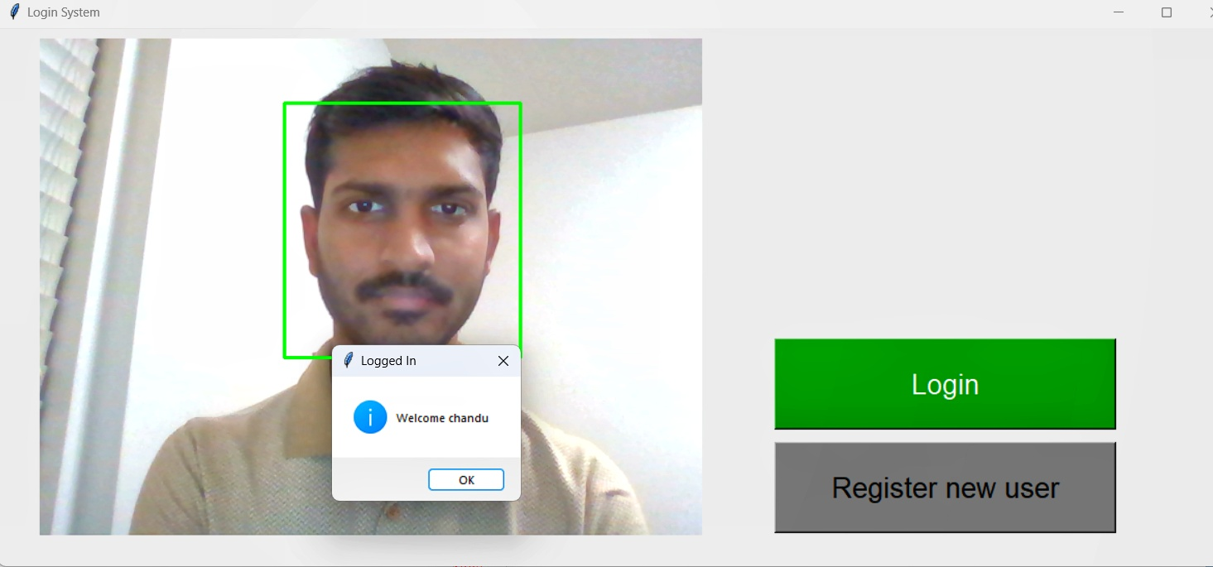
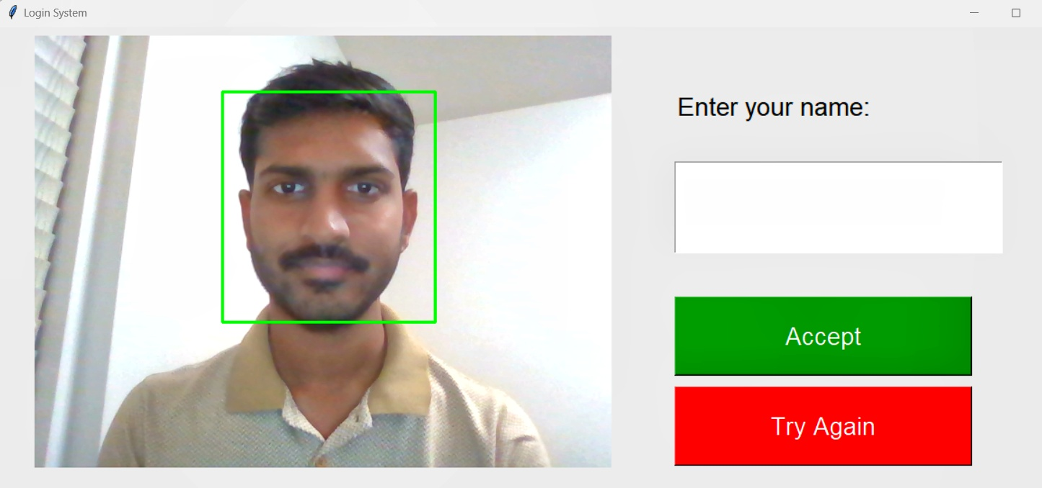
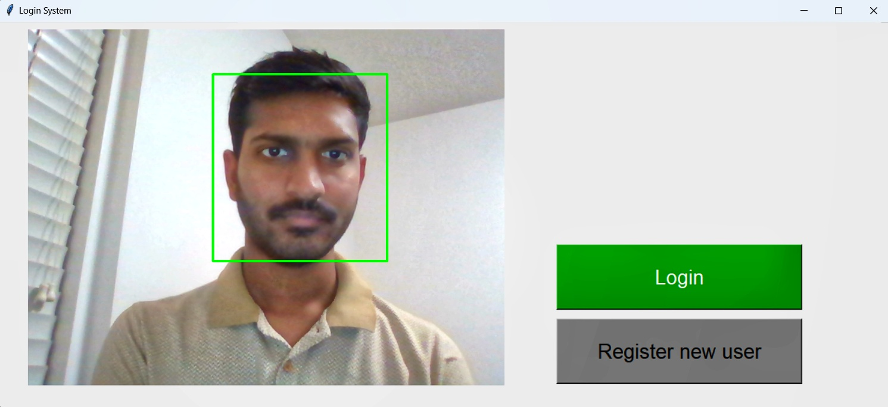
Demo :

Slide 10

Thank You

